Slide 1





P704: Product Recommendation System
Clustering-Based Product Recommendations at Scale
Team Members:
Vivek • Prakash • Karishma • Amit •
Rohit • Thasin • Darshan

Slide 2

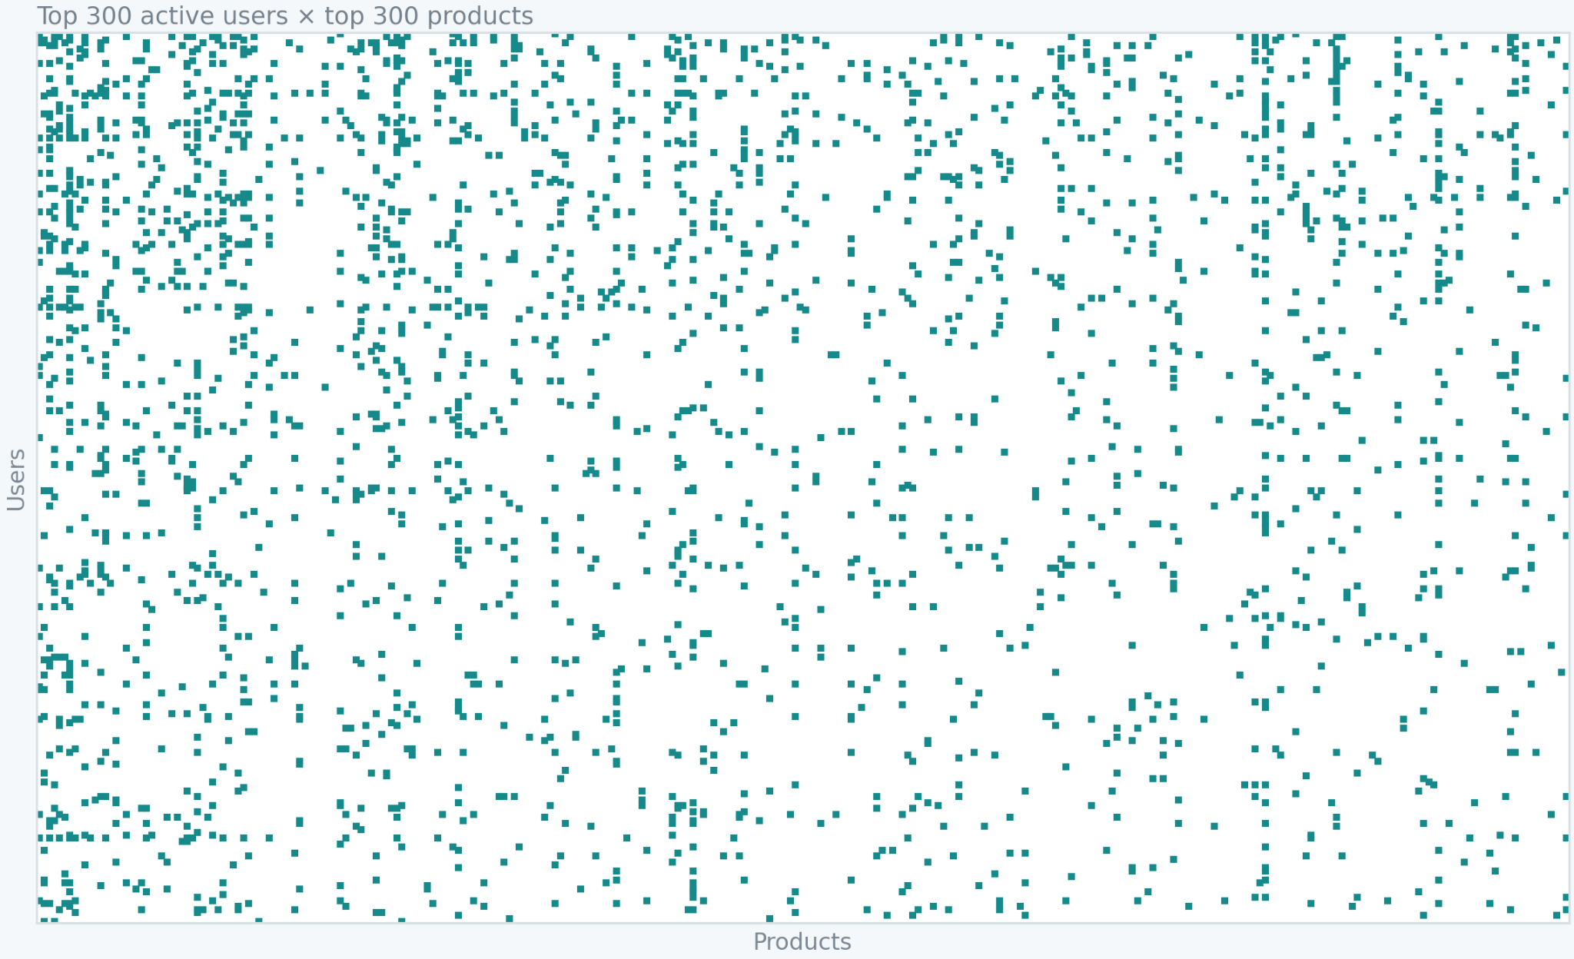
Problem and Project Objective
Build an end-to-end product recommendation system using user-rating behaviour, compare clustering approaches, evaluate Top-N recommendations, and deploy the selected clustering model.
7.82M
4.20M
476K
99.9996%
Interactions
Users
Products
Sparsity
User-product interaction matrix - Sparsity
Why this dataset is challenging
Median user history: 1 rating
37.76% of products have exactly 1 rating
Users
A dense user-product matrix would require about 14,901 GiB
The solution therefore uses chunked processing and sparse representations
Products
Notes:
This slide frames the business and technical problem: the data is very large and extremely sparse, so the solution uses memory-safe processing and sparse modelling rather than a dense user-product matrix.
1

Slide 3
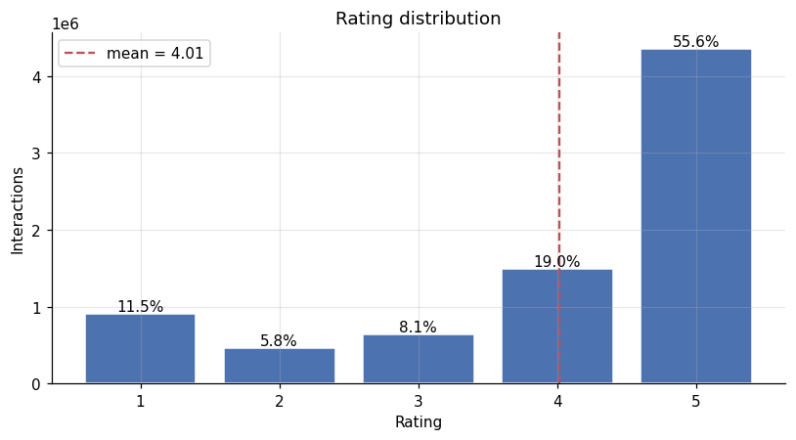
From Raw Ratings to a Leakage-Safe Modelling Dataset
Observed rating pattern informs the training and evaluation design.
74.55%
of ratings are 4-5 stars
Ratings are strongly concentrated at the high end.
That distribution is important when defining the positive holdout used for recommendation evaluation.
Leakage-safe modelling flow
01
02
03
04
05
Users with ≥5 interactions
Hold out 1 positive rating
Build training-only features and rankings
Cluster users
Recommend unseen Top-10
(Rating ≥ 4)
254,064
237,187
6.15%
Modelling population
Warm evaluation users
Cold-item holdouts
Notes:
1

Slide 4
Clustering Approaches and User Segments
Multiple clustering paths were compared, then Behavioral KMeans was selected for interpretability and deployability.
Approaches compared
Selected behavioural segments
KMeans k=4 cluster shares
Method
Representation
Model or role
Approach A
5 behavioural features
KMeans, k=4
Checks
Behavioural features
MiniBatchKMeans
and DBSCAN
39.06%
32.24%
Lower-activity /
positive
Lower-activity /
mixed
Approach B
50 SVD latent features
KMeans, k=6
Benchmark
Product popularity
Global Popularity
15.91%
12.79%
Higher-activity /
positive
Lower-activity /
critical
The benchmark is used for comparison and fallback, not as the deployed clustering model.
Final choice: Behavioural KMeans, k=4
Selected because it produced useful and interpretable behavioural segments while keeping the serving flow simple.

Slide 5
Recommendation Performance and Final Model Selection
Popularity is the strongest benchmark, but Behavioural KMeans was selected for interpretable and deployable clustering.
Evaluation results
Warm Hit Rate@10
Model
Warm HR@10
Catalog coverage
2.0
1.8133%
1.8606%
Behavioural KMeans
1.8133%
0.0115%
1.5
1.3550%
SVD + KMeans
1.3550%
0.0367%
1.0
Global Popularity
1.8606%
0.0067%
0.5
Observed HR@10 gap: Global Popularity leads Behavioural KMeans by 0.0472 percentage points.
0.0
Behavioural
KMeans
SVD +
KMeans
Global
Popularity
The gap is small in observed results, but not statistically tested.
Selected deployment model: Behavioural KMeans, k=4
Interpretable
Competitive
Higher warm HR@10
Deployable
Project fit
4 behavioural user segments
Close to popularity benchmark
Than SVD + KMeans
Simpler serving architecture
Satisfies clustering-deployment goal
Global Popularity remains the benchmark and fallback. Statistical significance of the small HR@10 difference was not tested.

Slide 6
Live Recommendation System
Saved clustering artifacts power three serving paths in the deployed Streamlit app.
Serving paths
Saved artifacts
Streamlit serving layer
Existing modelled user
Recommendation bundle
Saved cluster
cluster rankings & global ranking
Seen-item matrix
No runtime retraining
Artifacts are loaded once
excludes rated products
New user onboarding
5 ratings
Product metadata
No ratings.csv loaded
training-only statistics
Compact deployment package
Behavioural pipeline
No usable profile
Fallback
StandardScaler + KMeans, k=4
Live deployment
Live app
p704-recommendation-system.streamlit.app
01
Platform
02
Runtime
03
Raw data
Streamlit Cloud
Saved artifacts only
No ratings.csv
Hosted Streamlit app
No retraining during serving
Compact artifact-based deployment
Training-only historical statistics
Product IDs only, no names available

Slide 7
Live Recommendation System
Saved clustering artifacts power three serving paths in the deployed Streamlit app.
Serving paths
Saved artifacts
Streamlit serving layer
Existing modelled user
Recommendation bundle
Saved cluster
cluster rankings & global ranking
Seen-item matrix
No runtime retraining
Artifacts are loaded once
excludes rated products
New user onboarding
5 ratings
Product metadata
No ratings.csv loaded
training-only statistics
Compact deployment package
Behavioural pipeline
No usable profile
Fallback
StandardScaler + KMeans, k=4
Live deployment
Live app
p704-recommendation-system.streamlit.app
01
Platform
02
Runtime
03
Raw data
Streamlit Cloud
Saved artifacts only
No ratings.csv
Hosted Streamlit app
No retraining during serving
Compact artifact-based deployment
Training-only historical statistics
Product IDs only, no names available

Slide 8
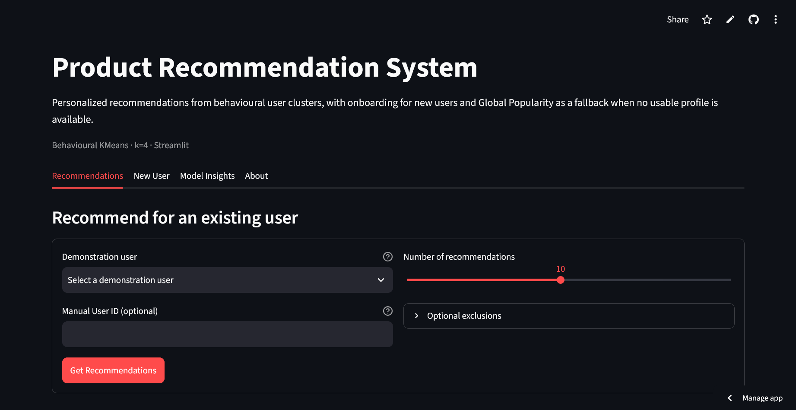
Deployed Streamlit Application

Slide 9
Thank You
Questions?

